Slide 1


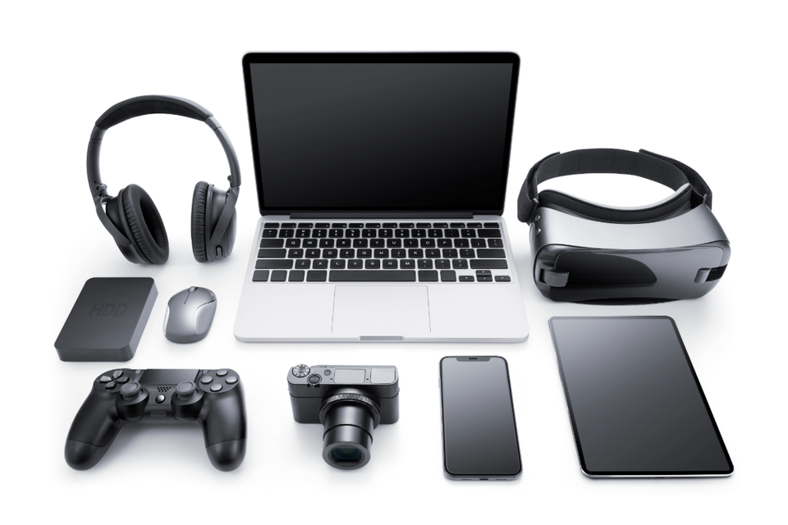

PKG
GADGET
APP
Presented By
Prabhat Poudel
Kapil Tiwari
Ganesh Tiwari

Slide 2

TABLE OF CONTENT
Introduction
Problem Statement
Objectives
Background Study
Methodology
Gantt Chart
Deliverables
Conclusion

Slide 3
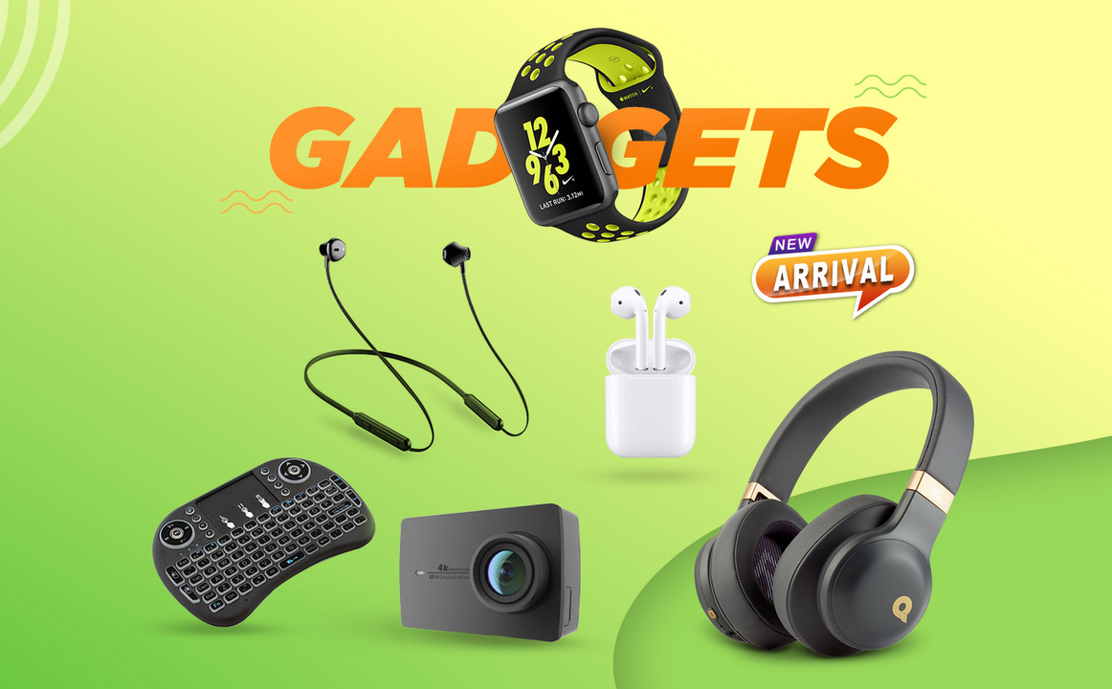
INTRODUCTION
The Gadget App E-Commerce project is an all-in-one online shopping platform for electronic gadgets. It helps businesses manage products, orders, payments, and reports efficiently. With features like real-time stock updates, secure payments, and easy navigation, it improves the shopping experience for customers while boosting business growth and productivity.

Slide 4


PROBLEM STATEMENT
Small and mid-sized gadget retailers face challenges in managing e-commerce without a proper mobile app.
Manual processes and disconnected tools cause errors and inefficiencies in inventory, orders, and customer management.

Slide 5



OBJECTIVE
To provide a user-friendly and efficient system that enables sellers to manage gadget products and e-commerce operations effectively and efficiently.
To collect, store, organize, retrieve, and present product information and customer data for a seamless shopping and management experience.

Slide 6

BACKGROUND STUDY
Current Market Gaps: Local Gadget selling stores lacks full seller-side tools such as real-time inventory tracking, mobile apps, and advanced analytics.
Observed Retail Challenges: Small gadget stores face inefficiencies due to disconnected systems, manual processes, and data entry errors, limiting their ability to scale.
Our Solution: A mobile-first, cross-platform app enabling real-time product, order, and inventory management—designed to simplify operations for small to mid-sized electronics retailers.

Slide 7

METHODOLOGY
We used the Iterative Model for development, repeating steps like planning, designing, coding, and testing. This approach helps us improve the app in each cycle based on feedback, making it more reliable, user-friendly, and efficient.

Slide 8
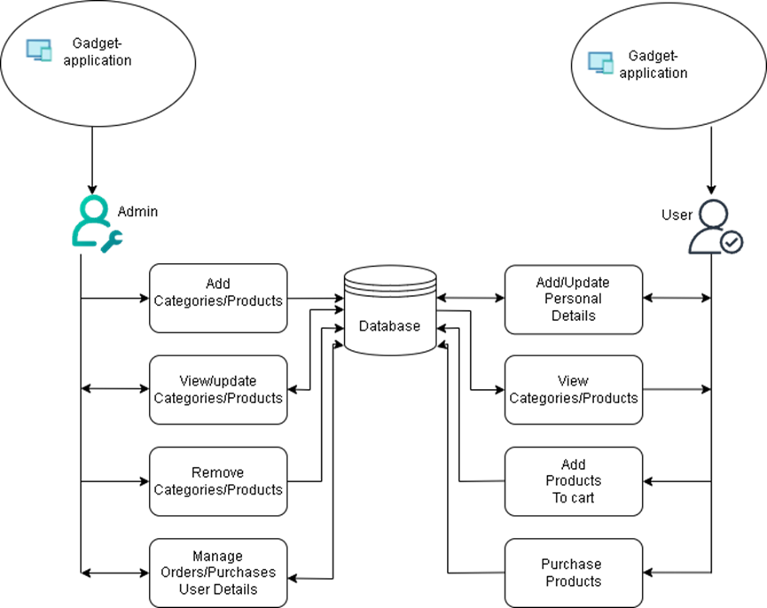

Slide 9
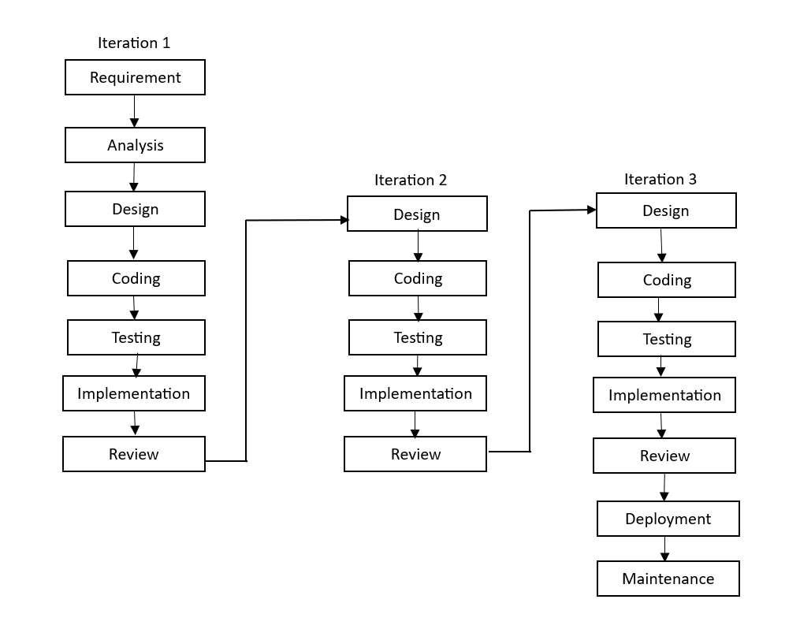

Slide 10
DEVELOPMENT PHASES (ITERATIVE MODEL):
Requirement Gathering: Collected app features like product management, orders, and payments.
Analysis: Analyzed needs, identified gaps, and created flowcharts/wireframes.
Design: Designed UI, database (MongoDB), and backend structure (Node.js/Next.js).
Coding: Built the app using typescript , react native and backend with Node.js and MongoDB.
Testing: Tested for functionality, performance, and security.
Implementation: Ran the app on test devices, verified its features, and demonstrated it.
Review: Collected feedback, fixed bugs, and added updates as needed.
Notes:
Requirement Gathering: Collected key app features – product management, orders, payments.
Analysis: Studied needs, found missing parts, and made flowcharts and wireframes.
Design: Created the user interface, database (MongoDB), and backend layout (Node.js/Next.js).
Coding: Built the app using Java/Kotlin; backend done with Node.js and MongoDB.
Testing: Checked the app for bugs, speed, and security.
Implementation: Ran the app on test devices, verified features, and demonstrated its functionality.
Review: Got user feedback, fixed issues, and made improvements.

Slide 11
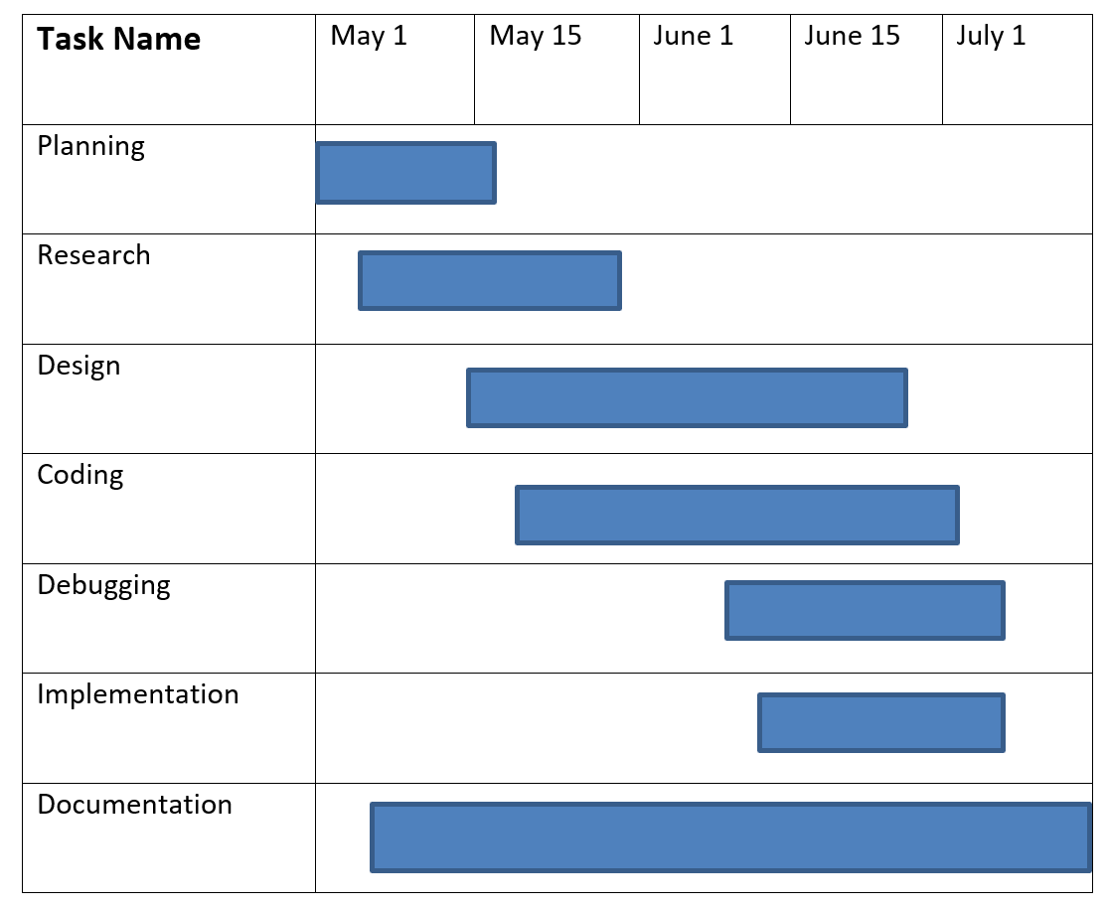
GANTT CHART

Slide 12

DELIVERABLES
Development of a fully functional mobile application that is user-friendly, flexible, and easy to manage.
Preparation of a comprehensive user manual to guide end-users through the application's features and functionalities.
Compilation and submission of a detailed final report documenting the entire development process, methodologies used, and outcomes achieved.
Notes:
Create a working mobile app that is easy to use and manage.
Write a clear user guide to help people use the app.
Write a final report explaining how the app was made and what was achieved.

Slide 13

CONCLUSION
The Gadget E-Commerce App is a smart, scalable solution for managing online sales and inventory. It offers customizable features, real-time updates, and secure payments, making it easy for sellers and customers to use. This app helps businesses improve efficiency and grow in the e-commerce market.
Notes:
The Gadget E-Commerce App helps businesses sell products online and keep track of their stock.
It’s easy to change features to fit your needs, shows updates right away, and keeps payments safe.
This makes things easier for both sellers and buyers, and helps businesses work better and grow.

Slide 14
REFERENCE
Rouse, M. (2017). Mobile application development (mobile app development). TechTarget. https://www.techtarget.com/searchsoftwarequality/definition/mobile-application-development
ITTI Pvt. Ltd. (n.d.). ITTI Computers - Your Trusted IT Training Institute in Nepal. Retrieved May 7, 2025, from https://www.itti.com.np
Nagmani International. (n.d.). Official distributor of ASUS and other tech brands in Nepal. Retrieved May 7, 2025, from https://www.nagmani.com.np

Slide 15
THANK YOU !!

